Slide 1
Linear Algebra
Vectors
Scalars
Vector Operations
Vector Spaces

Slide 2


Vector
Scalar
Magnitude
Direction
Magnitude
Direction
Examples
Displacement - 11mt East
Velocity – 15m/s at 30°
Acceleration - Mt/s²
Force = mass×acceleration
Examples
Distance - 11mt
Speed – 15m/s
Time - 2Hrs
Power – 20 Watt
The Vector changes when change happens in either (1.) magnitude (2.)direction or (3.) both
The Vector changes when the only magnitude changes.

Slide 3
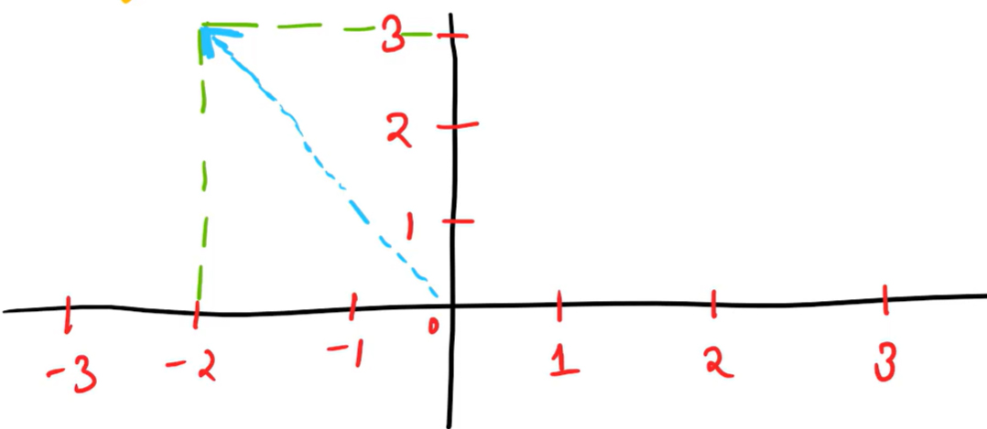
Always think Vector as Lines (Arrowed) originating from (0,0)
2D Vector=(-2,3)

Slide 4
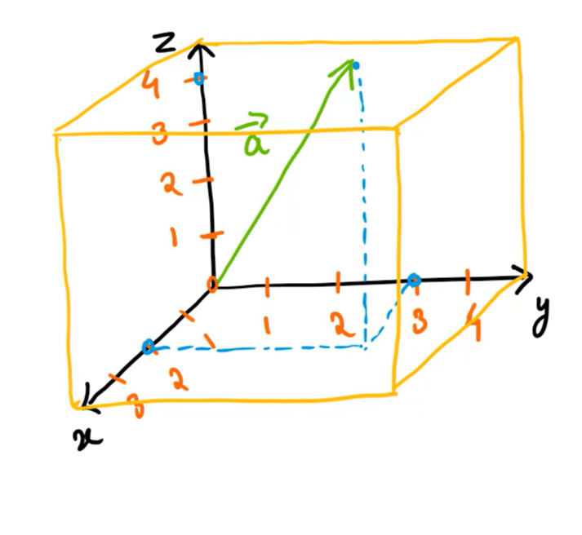
3D Vector=(2,3,4)

Slide 5


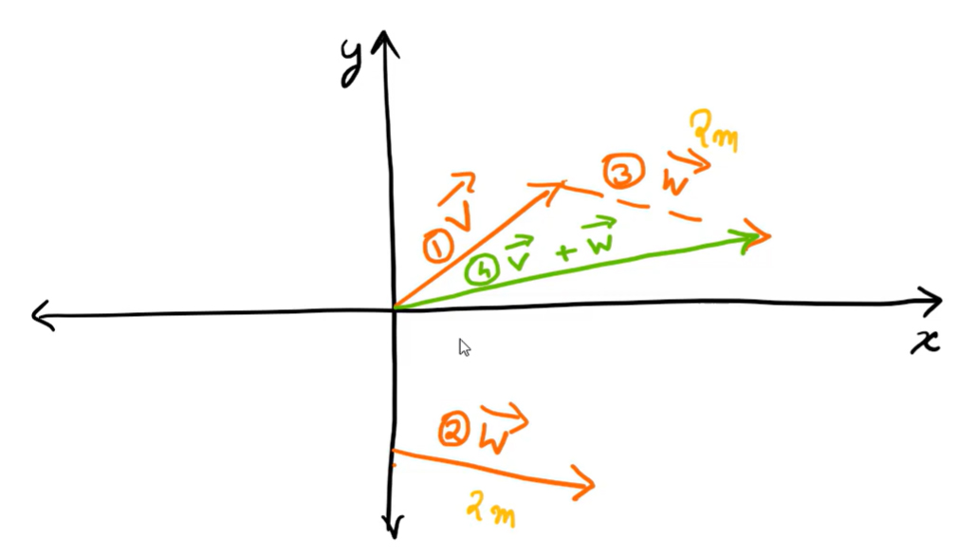
Adding Two Vactors
Copy Vector to tip of Vector
Draw Vector Originating from last of to tip of

Slide 6
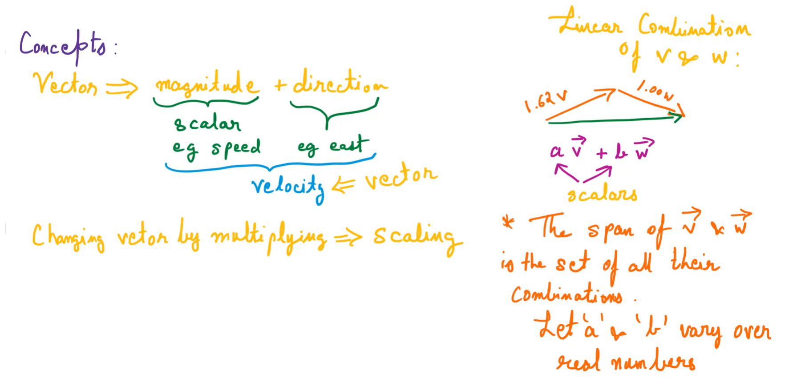

Slide 7
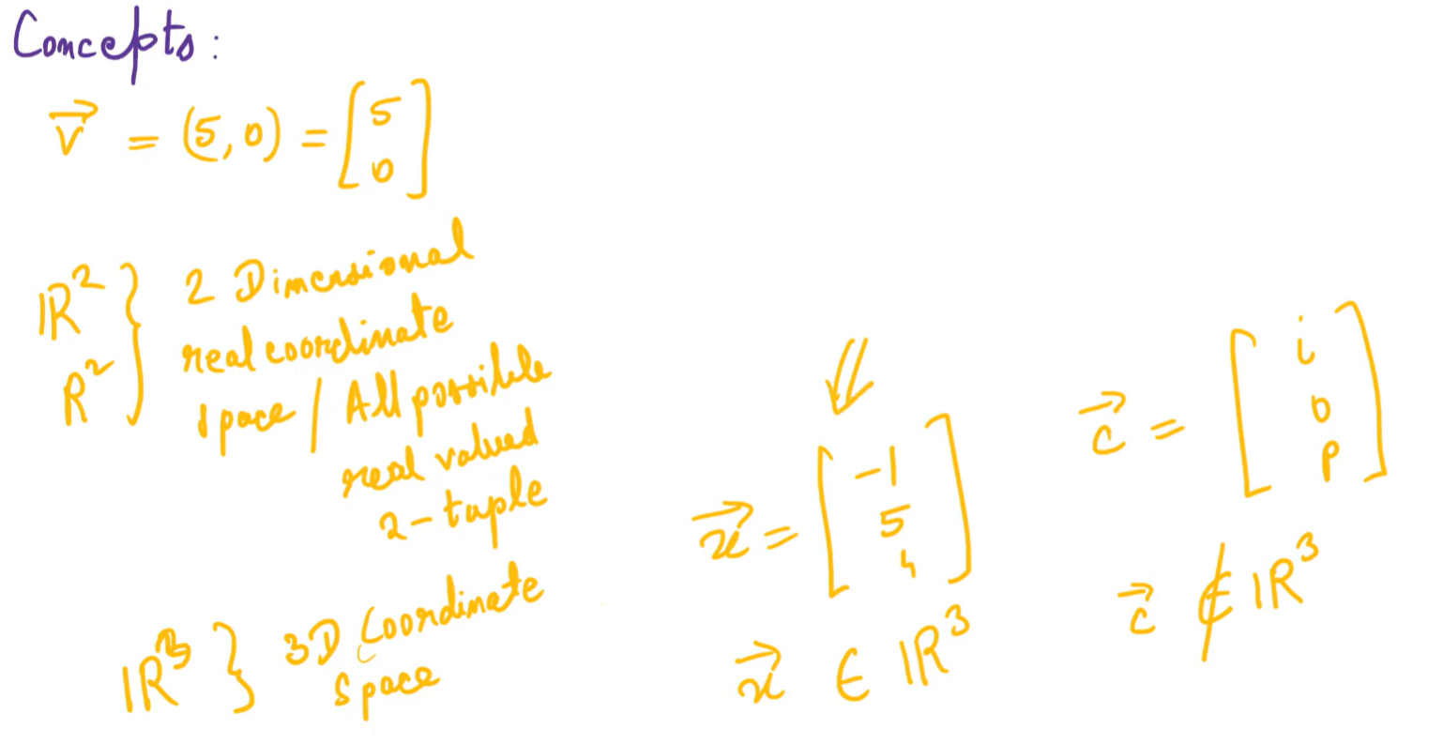

Slide 8
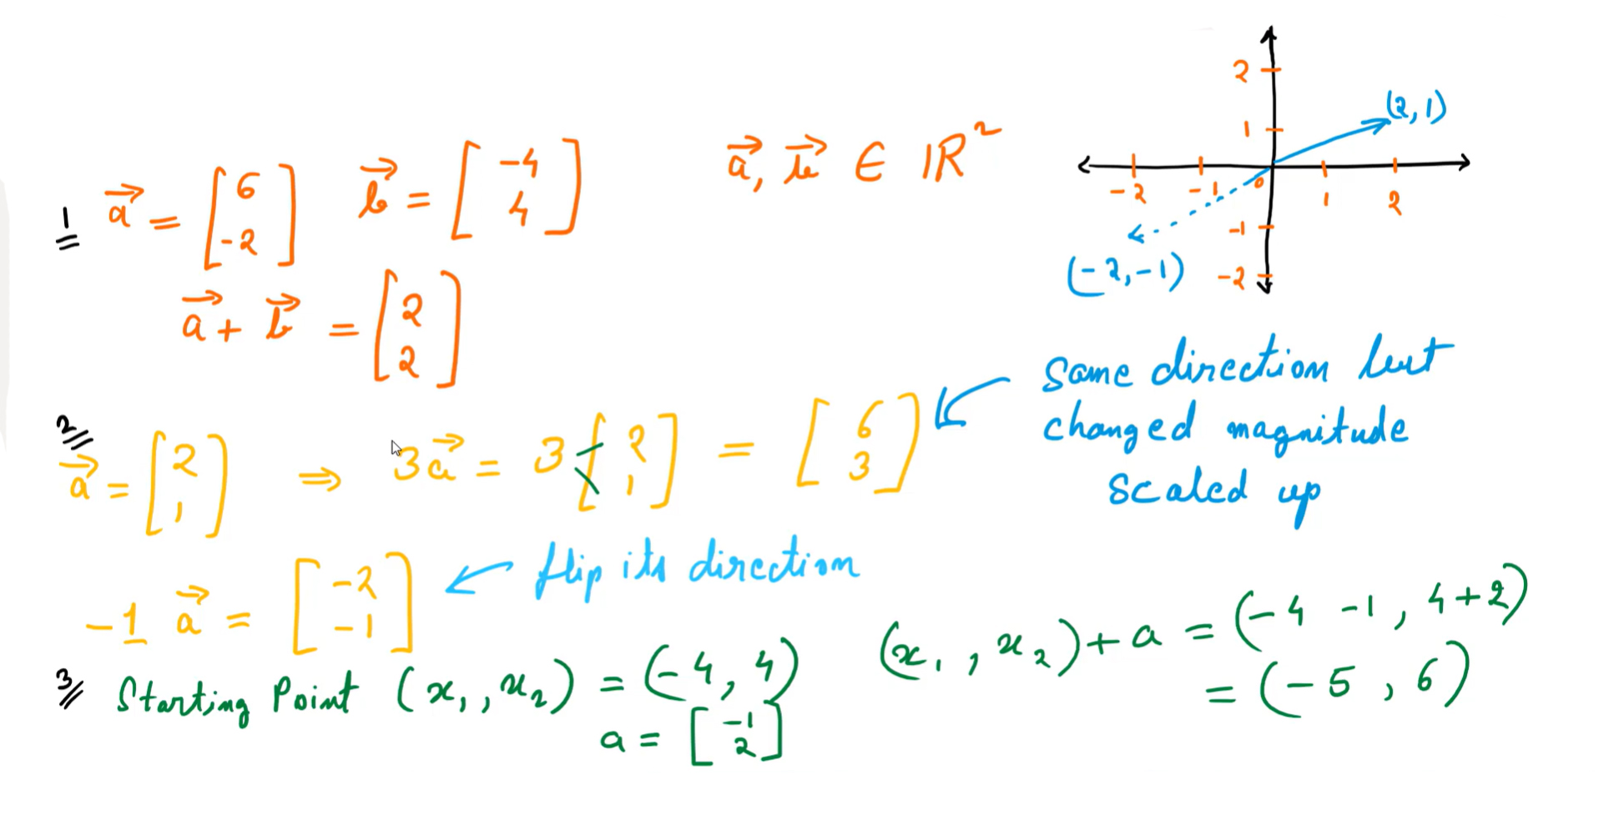

Slide 9
